Slide 1

Expanding Apprenticeships for People with Disabilities
David Hoff
Institute for Community Inclusion, UMass Boston
david.hoff@umb.edu
617-480-9230
www.communityinclusion.org

Slide 2
Handout
Presentation Outline

Slide 3
If you would like copies of the PowerPoint slides, please email david.hoff@umb.edu

Slide 4
Apprenticeship Initiatives
  The Rural Youth Apprenticeship Development Project (RYAD)
  Partner in JFF's National Innovation Hub for Diversity, Equity, Inclusion, and Accessibility in Registered Apprenticeship
  Partner in Massachusetts Diversity and Equity in Apprenticeship Initiative
Notes:
JULISA / DAVID
•The Rural Youth Apprenticeship Development Project (Julisa)
•JFF's National Innovation Hub for Diversity, Equity, Inclusion, and Accessibility in Registered Apprenticeship (David)
•Partner in Massachusetts Diversity and Equity in Apprenticeship Initiative (David)
•
The Rural Youth Apprenticeship Development Project promotes the development and advancement of State and American Indian VR apprenticeships programs for youth with disabilities in undeserved rural communities where there are higher rates of people with disabilities who face lower rates of employment.
We have defined youth as those ages 16-24 and agencies can focus on pre-apprenticeship, non-registered apprenticeships or registered apprenticeships. We are working with 4 VR agencies,
Arkansas Rehabilitation Services and Arkansas Career Development Center
Created pre-apprenticeship programs that feed into registered apprenticeships in construction and healthcare
Mentor role
Vermont HireAbility (general VR agency)
Received one of the Rehabilitation Services Administration Career Pathways demonstration grants.
Partnered with workforce partners, state apprenticeship office, secondary and post-secondary education institutions, non-profit partners and Vermont employers to create registered apprenticeships in 5 target sectors
Their model includes Career Pathway Navigators, a Governance Board with leaders from all partner organizations, and an Employer Advisory Group representing the targeted sectors
Vermont Division for the Blind and Visually Impaired
Create either a pre-apprenticeship or non-registered apprenticeship
Focused on access and accessibility for youth that are blind or visually impaired
Looking at remote work options, IT, technology and civil service opportunities
Wyoming Division of Vocational Rehabilitation
Working with state apprenticeship office and secondary and post-secondary education institutions including the Makerspace programs
There is a need for pre-apprenticeship programs to create a pipeline for the existing apprenticeship programs
Work collaboratively with the Tribal VR program
Focused on construction and IT, two of the fastest growing industries that matched the youth career interest
Our team provides technical assistance (TA), assistance with identification and coordination with potential partners and guidance on evaluation strategies. Our TA model includes both individual support as well as the infrastructure, a learning collaborative, that brings members together in a cross-state forum to solve problems, identify and apply solutions, and measure outcomes and results through research and evaluation activities.
We have an advisory group that includes representatives from the various stakeholders; i.e. apprenticeship office, VR agencies, transportation, etc.
One of our project outputs is an apprenticeship toolkit with rural-specific resources. The toolkit will include policies that support apprenticeship programs in rural areas, implementation guides, sample tools like marketing material, and case scenarios. We have already developed the toolkit infrastructure and have a number of tools already available. These are intended for a broader audience and we are now working on rural and youth specific tools. If we have time, we will pull up the toolkit and give you a quick tour.

Slide 5
Work-Based Learning
Work-Based Learning
Apprenticeship
Internship
On-the-Job Training
Co-Op
Transitional Employment

Slide 6


Bringing together two worlds
Disability
Apprenticeship

Slide 7
What is apprenticeship?
Apprenticeship
Paid job
Mentoring
Results in Industry Credential
Related instruction
Scheduled Wage Increases

Slide 8
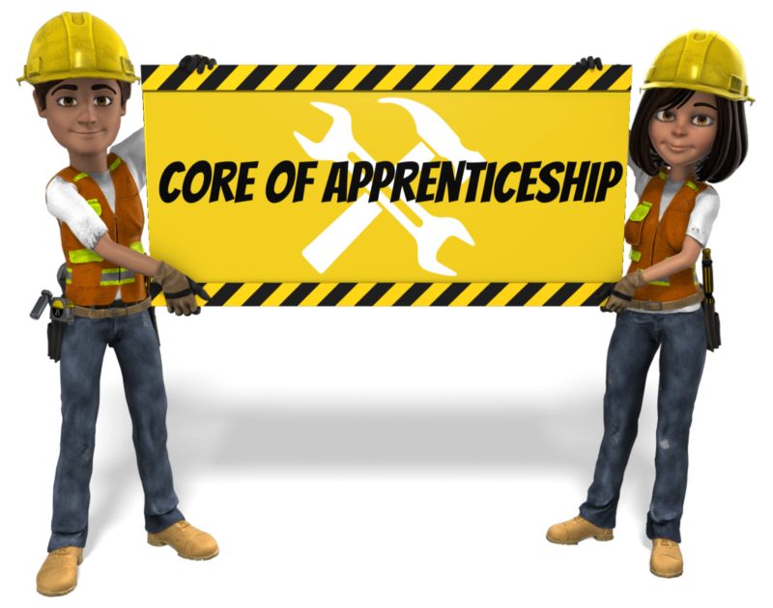
The core of apprenticeship…
Highly structured systematic approach to competency development over time resulting in an industry credential
Individuals are trained based on industry standards
Notes:
DAVID

Slide 9
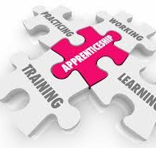
Apprenticeship Models
Pre-Apprenticeship:
preparation for apprenticeship
Registered apprenticeship: apprenticeship registered with US Department of Labor
Industry apprenticeships:
use an apprenticeship model, but not registered
Notes:
DAVID
In the training last week, only about 30% of you mentioned using apprenticeships/ pre apprenticeships as an EE strategy. If you have not, why not?...One of the challenges that we heard most often is that businesses, jobseekers, and VR staff do not have a good understanding of the models and the benefits. I'll spend some time defining the first two now, and Neil will describe the registered apprenticeship model later when we talk about model advancement.
Because apprenticeship combines on-the job training and related classroom instruction with a steady paycheck, it offers an ideal solution for the 68 percent of Americans with disabilities who are job seeking and are engaged in employment-related activities. These activities may include preparing for work, actively searching for jobs, currently participating in employment, or seeking to improve their employment situation.
Apprenticeship has the potential to solve a modern challenge which has some job seekers sidelined even when demand for talent is high. Driven by the 2017 Executive Order on Expanding Apprenticeships in America, the U.S. Department of Labor (DOL) is committed to increasing opportunities for talent development in the workplace.
Apprenticeships:
Are a long-standing model used for entry into careers in the trades, but now expanded well beyond the trades
Grew out of employer needs to hire and train qualified workers with specific skills to do the job
Unlike other WBL models described earlier apprenticeships have a very defined structure and set of expectations
Require a combination of on-the-job training and classroom learning that leads to a credential
Are an Earn and Learn model with, as we said earlier, significant earnings potential
Are a system for training a new generation of workers in a trade or profession
In 2006, the Vision for 21st Century Apprenticeship initiative outlines use of Registered Apprenticeships to:
Keep pace with economic changes
Offer skill development through a competency-based training system
Offer interim credentials in high growth/demand industries (healthcare, biotech, advanced manufacturing, info tech, and more)
Be a talent development strategy & key option to post-secondary education
Built off pilot models around the country

Slide 10
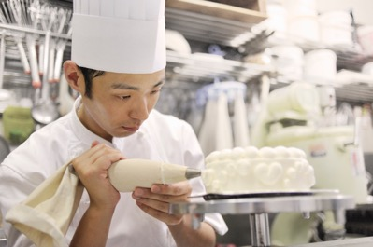

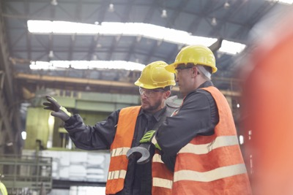



Apprenticeships can be in a diversity of fields

Slide 11


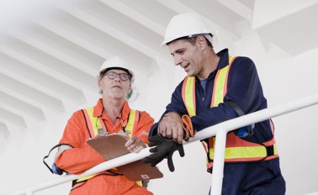

Why apprenticeship?
For individuals: highly structured, systematic earn and learn approach resulting in skill development, stable employment, and movement along a career pathway.
For employers/businesses: opportunity to hire & train individuals according to industry standards, and meet workforce needs.

Slide 12
Apprenticeship Structure
Employer: On the Job Training
Sponsor
Related Instruction
Support Services
Notes:
DAVID

Slide 13

Partnership is Key
Apprenticeship
USDOL Apprenticeship Office
SD Dept. of Labor & Regulation
Community Colleges
Local Education (K-12)
Vocational Rehabilitation
Community Organizations
Employers
Labor Organizations
Economic Development
Other

Slide 14

Registered Apprenticeship Requirements
Minimum of 2000 hours of on-the-job training (time-based approach)
  Competency approach also an option
Minimum of 144 hours of related instruction annually (recommended)

Slide 15

Options for Measuring Skill Acquisition
Time-Based: Completion of at least 2,000 hours of on-the-job learning
Competency-Based: Apprentice successfully demonstrates skills and learning acquired through on-the-job learning
Hybrid: Combination of time-based and competency-based
Determined by Sponsor

Slide 16
Apprenticeships are Highly Structured
Clear standards and requirements
Apprenticeships based on industry standards
Positions broken down into highly detailed competency requirements

Slide 17
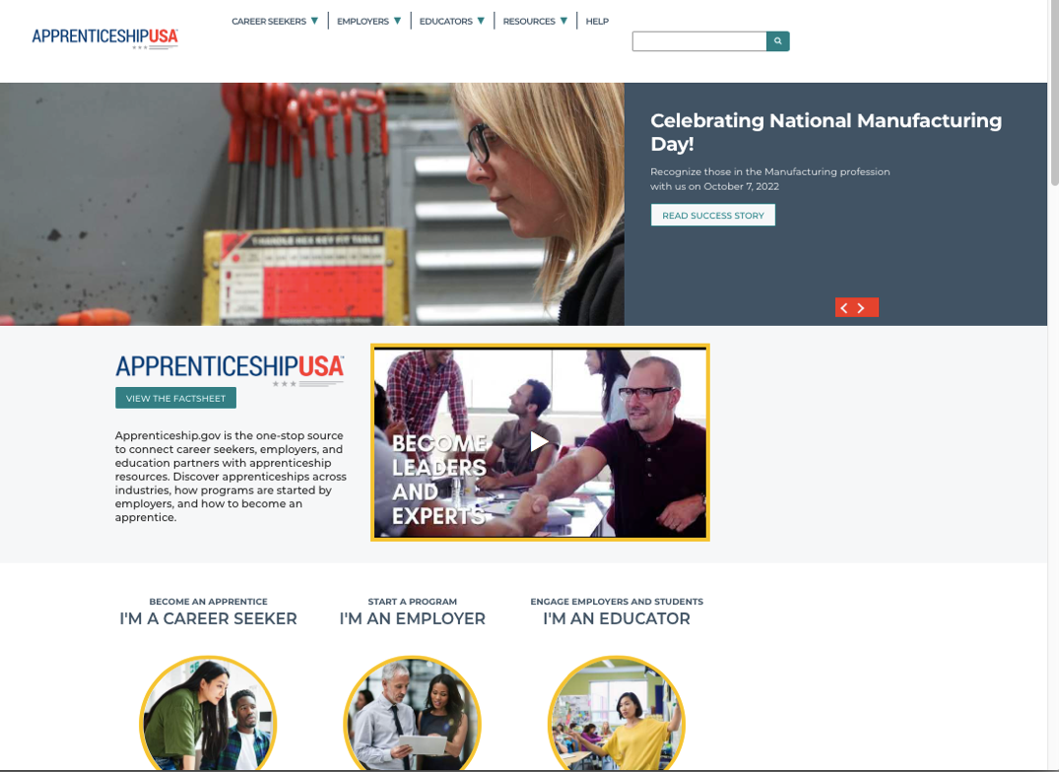
Apprenticeship Administration: Federal
USDOL Office of Apprenticeship
www.apprenticeship.gov

Slide 18
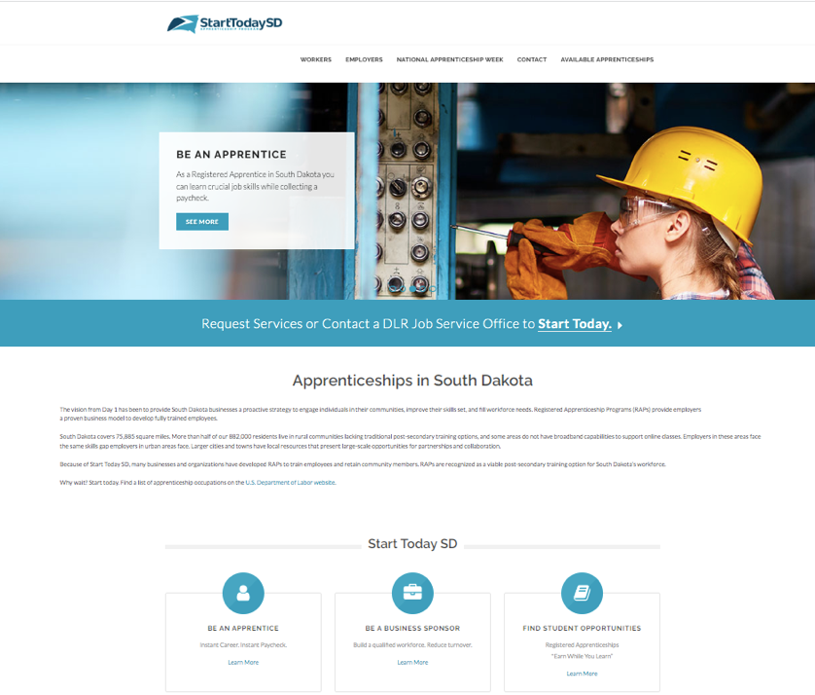
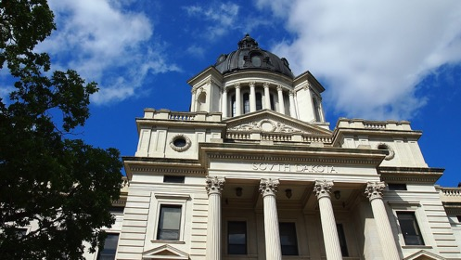
South Dakota: Apprenticeship Structure
In SD, USDOL Office of Apprenticeship registers & oversees programs
State administration by SD Department of Labor & Regulation (DLR)
  DLR staff provide case management to assist in retention
  One-Stop Career Centers/Job Service Offices are a primary conduit for apprenticeships
Online portal: starttodaysd.com
This Photo by Unknown Author is licensed under CC BY-SA

Slide 19
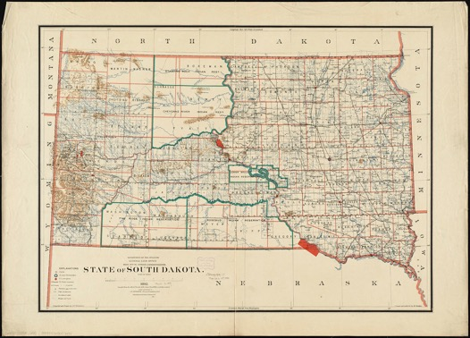
Apprenticeship in South Dakota
Approximately 220 registered apprenticeship programs.
  Most apprenticeships are currently in traditional apprenticeship occupations.
In 2020, DLR implemented Registered Apprenticeship Pathways Program.
  Allows high school students to concurrently earn high school credit, Registered Apprenticeship hours, post-secondary credit, and on-the-job experience.
DLR using federal and state funding to foster relationships between state technical colleges, industry associations and associations, and businesses to build Registered Apprenticeship programs in STEM industries.
DLR is creating materials teachers or DLR Career Advisors can use to increase student awareness of Registered Apprenticeships as a post-secondary option.
DLR has committed to expanding access for under-represented populations, including individuals with disabilities.
This Photo by Unknown Author is licensed under CC BY

Slide 20
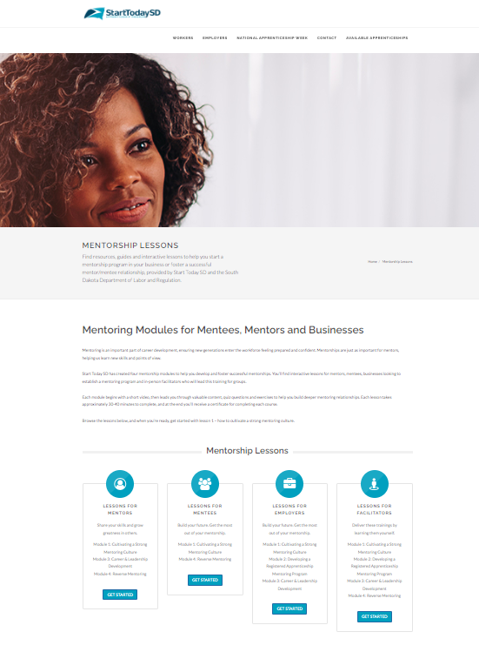
SD Apprenticeship Mentorship Toolkit

Slide 21
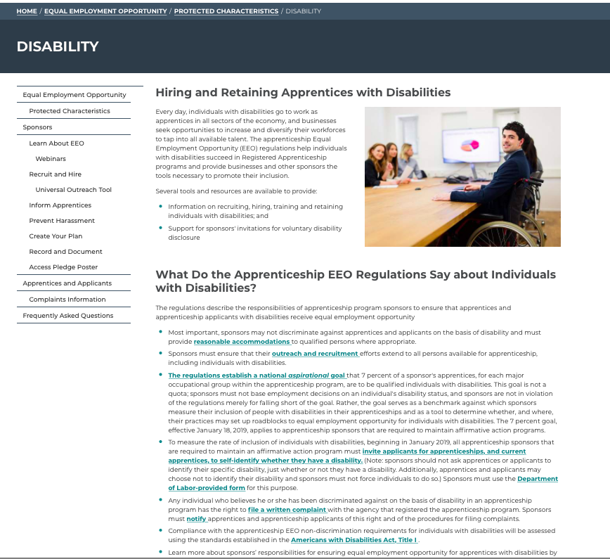
USDOL Efforts to Increase Participation of People with Disabilities in Apprenticeships

Slide 22
2016: Updated Apprenticeship EEO Regulations
Prohibits discrimination based on disability, and requires provision of reasonable accommodations.
Sponsors must ensure that outreach and recruitment efforts are inclusive of people with disabilities.
Establishes an aspirational goal that 7% of sponsor’s apprentices in each major occupational group have a disability.
Sponsors with 5 or more apprentices must have affirmative action plan, and request voluntary disclosure of disability by applicants and apprentices.

Slide 23

US Department of Labor
Registered Apprenticeship Technical Assistance Centers of Excellence
Four years: 7/1/21 to 6/30/25
4 Centers
  Diversity and Inclusion
  Strategic Partners & Alignment
  Occupations & Standards
  Data, Performance, Best Practices

Slide 24
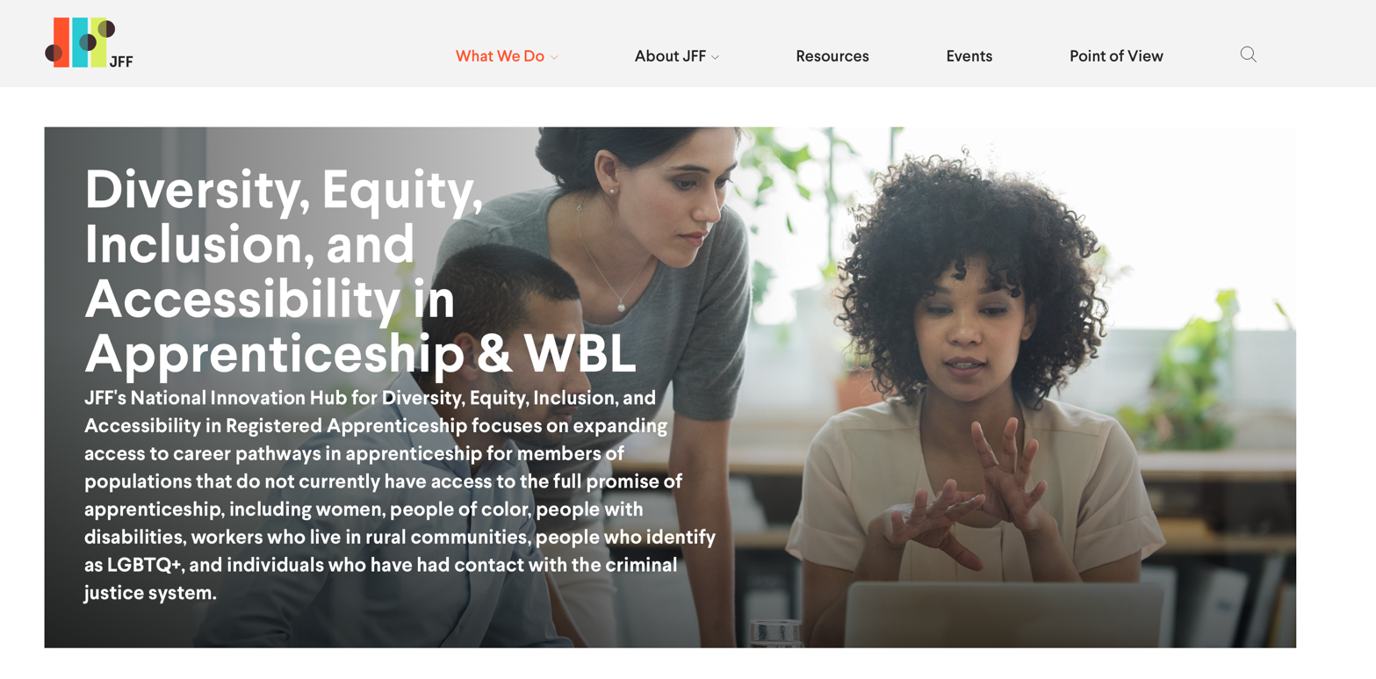
JFF Diversity, Equity, Inclusion, and Accessibility in Apprenticeship & WBL

Slide 25








Diversity, Equity, Inclusion, & Accessibility Center Team
Lead
Jobs for the Future
Rutgers Center for Minority Serving Institutions
The Apprentice School of Newport News Shipbuilding
Donna Lenhoff,
EEO Attorney
Institute for Community Inclusion, UMass Boston
Intelligent Partnerships

Slide 26




Opportunities For People with Disabilities in Apprenticeship
Increased opportunities for good jobs at good wages
Career pathway for developing skills and increasing wages
Systematic approach to competency development
Meeting labor market demands
Demonstrates capabilities of people with disabilities resulting in increased overall opportunities

Slide 27

Potential Challenges for People with Disabilities in Apprenticeships
Highly structured, potentially lacking flexibility that many people with disabilities may need
Many apprenticeships are full-time
Don’t always fit into “traditional” apprenticeships
Need to negotiate for accommodations for application and during apprenticeship
Support needs
Transportation requirements
Other

Slide 28
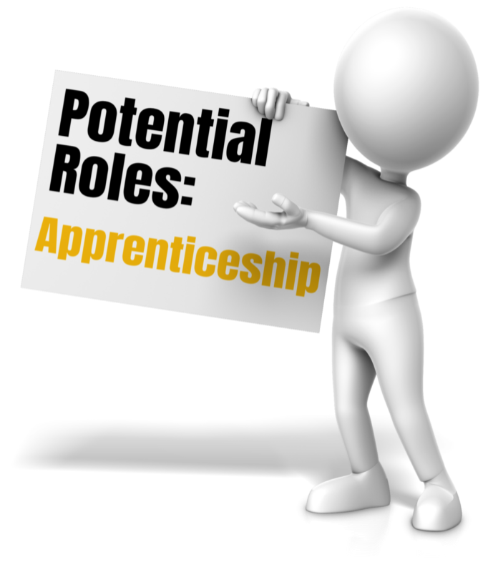
Disability Agencies & Organizations
Partner
Support Services
Funding
Provider of Related Instruction
Sponsor
Employer
Other

Slide 29

Next Steps
Increase knowledge of apprenticeship
Connect with and build relationships apprenticeship activities and partners in SD
Attend apprenticeship related events
Consider potential roles in apprenticeship
Other

Slide 30
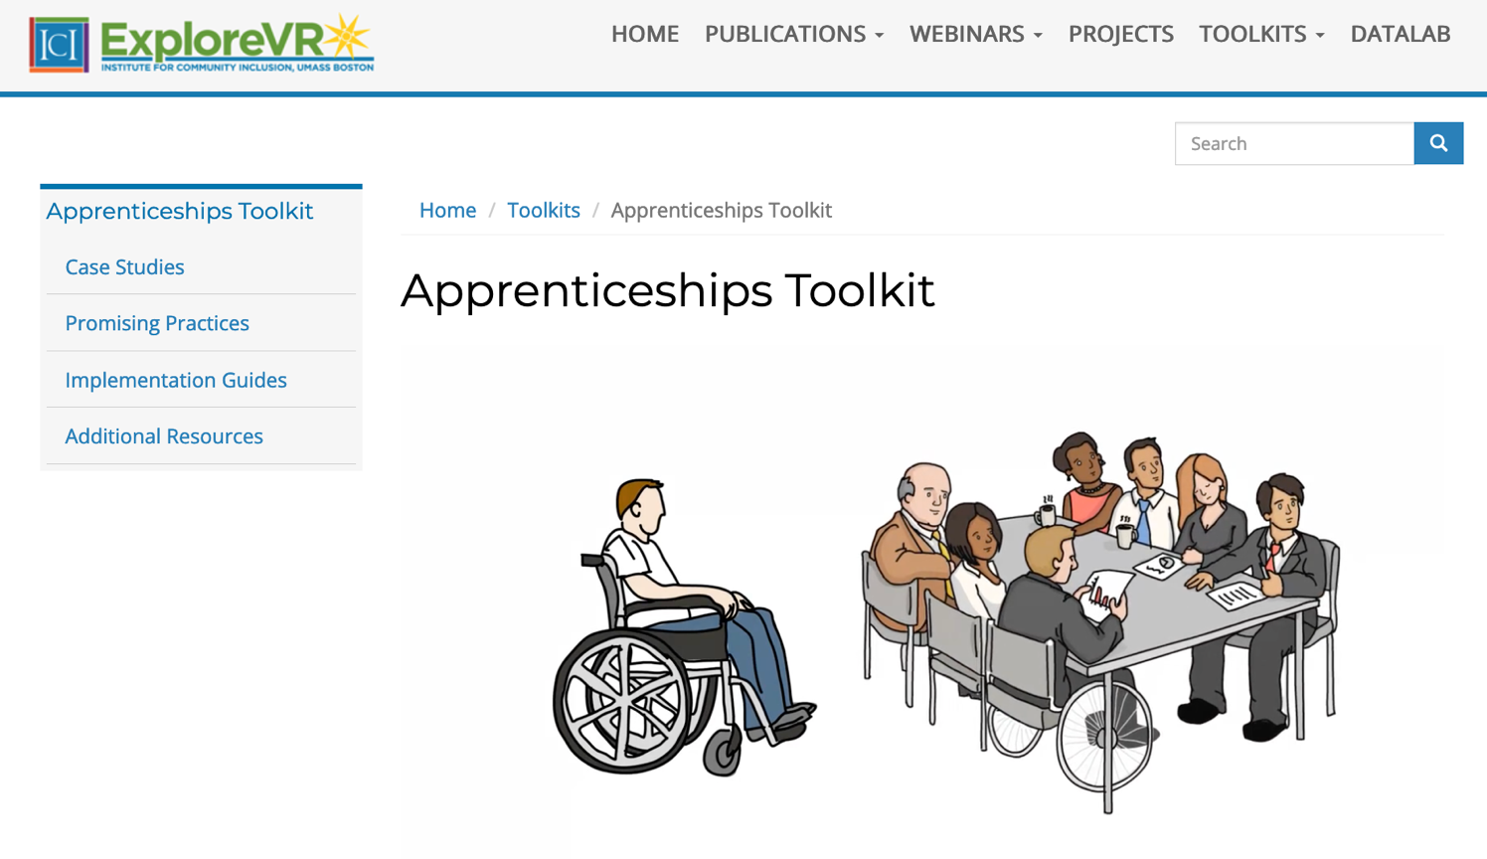
Apprenticeship Toolkit
Notes:
JULISA
An online interface of multimedia tools providing information and promoting implementation of Apprenticeship models.
The toolkit is housed on ExploreVR. It’s been operating for 10 years so we have a robust listserv comprised primarily of VR professionals​. Since it is the website we use for all VR projects, we write it in on every proposal we write so it has built in sustainability and maintenance. Currently we have 6 toolkits on the site. I encourage you to check out that toolkit.
Resources- show the toolkit
-highlight state examples
-include JFF
There is a wealth of information on both models available through DOL and other entities. We have toolkits with examples from state VR agencies that have implemented the models on ExploreVR. This includes Success stories, marketing material and implementation guides like the apprenticeship one we used for our large group discussion. We encourage you to take a look if you're interested in finding out more about either model.
We include detailed information about tools’ expected benefits and resources required for tool implementation.
Target Audience
State VR Agencies
Primary Objective
Define Apprenticeships
Showcase promising practices
Support implementation
Content
Descriptions and briefs
Videos and podcasts
Sample tools

Slide 31

Questions and Discussion

Slide 32
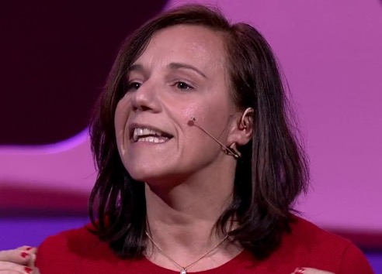
Emilie Weight
“Better integration of disabled people in our society, might not mean to assimilate them into whatever we deem ‘normal’, but rather to understand how they complete us.”

